Slide 1
An Analysis of Cyberbullying Detection with Machine Learning Methods
Justin Johnson
CAP6673 – FAU Spring 2018

Slide 2
Introduction
Intro to Cyberbullying
Challenges of Automated Cyberbullying Detection
Overview of Case Studies
Data Collection & Labelling
Feature Selection
Model Training and Evaluation
Conclusions

Slide 3
Intro to Cyberbullying
Bullying which occurs through electronic communication
Social media, chat groups, Q&A forums, etc.
Victims suffer mental and physical side effects
“54% of young people on Facebook had experienced cyberbullying.” ~ Love Engman 2015 [3]
No time restrictions – occurs 24/7
Twitter alone contains over 300 million users, and growing [9]
Very difficult to monitor at scale

Slide 4
Intro to Cyberbullying
Effective classification systems can be trained to classify digital communication as bullying
Goal – reduce cyberbullying through automatic detection with machine learning

Slide 5
Challenges of Automated Cyberbullying Detection
Natural Language Processing Problem
Human language is complex
ambiguities
context specific meaning
sarcasm
many languages
dialects
cultural influences
Digital communication always evolving
New terminology and abbreviations introduced monthly

Slide 6
Challenges of Automated Cyberbullying Detection
Data Acquisition
No large cyberbullying data set of high quality freely available
Data must be acquired through query and crawling strategies
Imbalanced data (small percentage of bullying)
Very expensive and time consuming
Model performance will always be influenced by size and quality of training data

Slide 7
6 Case Studies Between 2011 – 2018 Reviewed
Group | Title | Date Published | Authors | Description
A | Modeling the Detection of Textual Cyberbullying | July 2011 | Dinakar et al. | Apply binary and multi-class classifiers on a corpus of 4500 YouTube comments.
B | Using Machine Learning to Detect Cyberbullying | December 2011 | Reynolds, K. | Use both rule-based and bag of words models on labelled Formspring.me data.
C | Automatic Detection of Cyberbullying on Social Media | June 2016 | Engman, L. | Performs two experiments on Ask.fm Q&A dataset and compares their results.
D | Mean Birds - Detecting Agression and Bullying on Twitter | May 2017 | Chatzakou, D. Kourtellis, N. Blackburn, J. De Cristofaro, E. Stringhini, G.Vakali, A. | Extract text, user, network, and session-based features from a Twitter corpus, then apply various classifiers to the problem of detecting cyberbullying.
E | Cyberbullying Detection with Weakly Supervised Machine Learning | July 2017 | Raisi, E. Huang, B. | The “first specialized algorithm for cyberbullying detection that allows weak supervision and uses social structure” to detect user rolls.
F | Detecting Cyberbullying and Aggression in Social Commentary Using NLP and ML | January 2018 | Sahay, K. Singh Khaira, H. Kukreja, P. Shukla, N. | Performing binary and multi-class classification, using YouTube comments and Twitter messages for a combined training data

Slide 8
Data Collection & Labelling
Data Sources Commonly Used
YouTube - Comments
Twitter - Tweets
Formspring.me – Q&As
Instagram
ASK.fm – Q&As
Data Labelling Methods
Amazon Mechanical Turk – crowd sourcing service commonly used to annotate data, often combined with majority vote
Manual labelling by researchers

Slide 9
Data Collection & Labelling
Group A
Manually scraped 50K YouTube comments from pages of controversial video
Controversial videos more likely to contain offensive language
Clustered comments into:
Physical appearance
Sexuality
Race & culture
Intelligence
Created final data set by manually labelling 1500 comments from each cluster

Slide 10
Data Collection & Labelling
Group B
Scraped 18,554 user pages site Formspring.me by
Data included
Q & A
User profile details
Outbound links
Page meta data
All data labelling outsourced to Amazon’s Mechanical Turk
Labelled data by answering questions:
Bullying vs non-bullying
Which words indicate bullying
Rank severity of bullying 1 - 1
Final data set: 13,562 posts, with 792 positive for bullying (5.8%)

Slide 11
Data Collection & Labelling
Group C
Recursively crawled ASK.fm Q&A site and collected 24K Q&A pairs
Researched manually labelled all instances
Final set contained 278 positive instances, just over 1%
Group D
Collected 1.65 million tweets with Twitter API
First 1 million tweets are randomly selected as baseline
Next 650K selected by querying with one of 309 hashtags
Hashtag are associated with offensive language and bullying

Slide 12
Data Collection & Labelling
Group E
Collected a large amount of data from 3 platforms
Twitter: 296, 308 tweets
ASK.fm: 2,863801 Q&As borrowed from Hosseinmardi et al.’s previous research [7]
Instagram: also borrowed from Hosseinmardi et al.
Outsourced labelling to Amazon’s Mechanical Turk
Group F
Collected 3,947 comments from YouTube and 2647 tweets from Twitter
Used a bullying data set provided by Imeprium on Kaggle
Data was from a previous machine learning contest
Researchers manually label data:
Bully, non-bully
Spam
Aggressor

Slide 13
Feature Selection
Group A
YouTube comments were prepared:
Removed stop words
Stemming
Special & repetitive character removal
Feature sets include:
TFIDF
List of negative words from Ortony lexicon
List of profane words
Frequently occurring POS bigrams

Slide 14
Feature Selection
Group B
Curated list of 296 bad words – gave each word a offensive severity level from the set {100, 200, 300, 400, 500}
5 feature sets created
Number of curse words at each level (NUM100, NUM200, … , NUM500)
Percentage of curse words at each level (NORM100, NORM200, … , NORM500)
Total number of words in the post
The weighted sum (SUM) of the curse words
Boolean value that is set true if user is posting anonymously

Slide 15
Feature Selection
Group C
ASK.fm pre-processing - Removal of stops words, stemming, case folding, link removal
Experiment 1:
Stanford parser used to identify grammatical dependencies between words
Used 3 dictionaries of offensive words to identify dependencies connected to offensive words
Experiment 2 consisted of 4 features sets:
TFIDF
TFIDF with increased term weight for offensive words
Number of bad words, total number of words, number of 2nd and 3rd person pronouns
Word relation features generated with Stanford Parser

Slide 16
Feature Selection
Group D
Twitter pre-processing – stop words, spam/url/punctuation removal,
Experiment 1:
Stanford parser used to identify grammatical dependencies between words
Used 3 dictionaries of offensive words to identify dependencies connected to offensive words
Experiment 2 consisted of 4 features sets:
TFIDF
TFIDF with increased term weight for offensive words
Number of bad words, total number of words, number of 2nd and 3rd person pronouns
Word relation features generated with Stanford Parser

Slide 17
Feature Selection
Group E
Data prepared from ASK.fm, Instagram, and Twitter
N-gram text features used in combination with PVC model

Slide 18
Feature Selection
Group F
Data cleaned of special characters, case folded, regularized
Grammatical corrections made to data
Features created for TFIDF vectors and count vectors
Feature set created for n-grams in range [1, 5]
SelectKBest feature selection used to reduce total feature set
Chi-Squared test selects the top scoring features
Final training data set has shape (5694, 4600)
5694 instances
4600 features

Slide 19
Feature Selection
Feature Selection Conclusions
Bag of words with TFIDF is very popular, used in many NLP tasks
Bag of words model does not capture position dependencies
Groups C and D both used word vectors
C used word vectors to identify new offensive words
D used word vectors instead of bag TFIDF values
Word vectors contain more meaning for each term - context, syntax, POS, semantic, and more
POS features help to identify offensive words in relation to pronouns
Group D explored more features than any other group:
Network based features, popularity, reciprocity, power differences, centrality scores, sentiment, and more
Feature set trimmed after analyzing feature significance

Slide 20
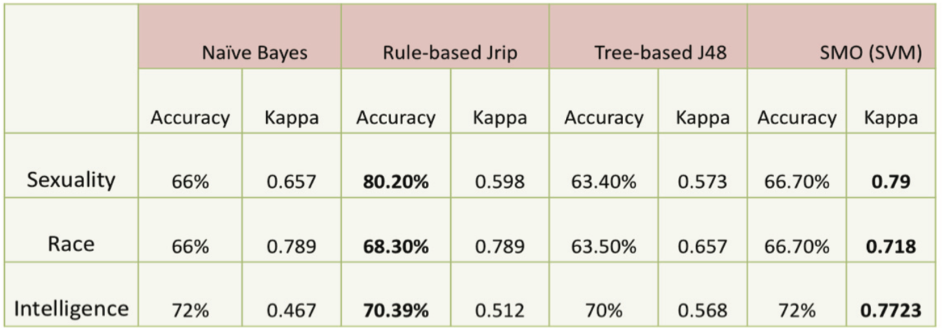
Model Training & Evaluation
Group A
Data set divided into 50% training, 30% validation, and 20% test
Binary classification performed better than multi-class classification
Jrip Rule Based achieved highest accuracy
SVM scored highest Kappa score

Slide 21
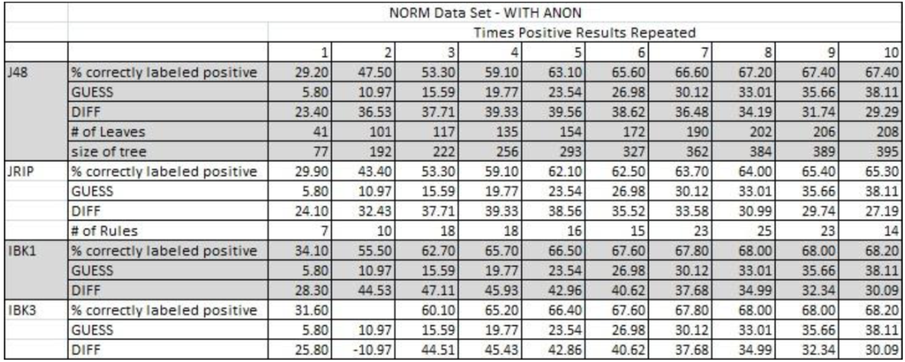
Model Training & Evaluation
Group B
First experiment (rule based) performed better than second experiment (bag of words)
Group concluded:
NORM outperforms NUM
Inclusion of anonymity feature improves performance

Slide 22
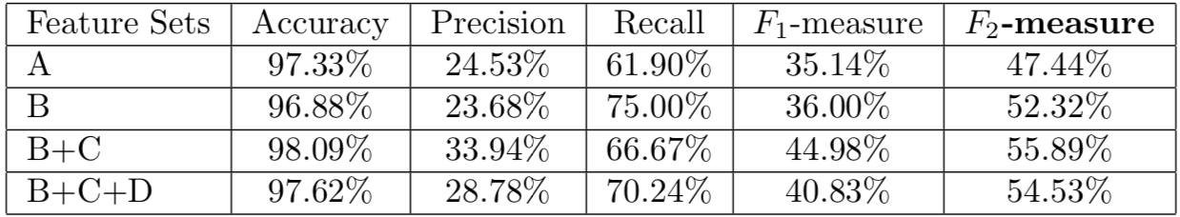
Model Training & Evaluation
Group C
Data (23,684 instances) was divided 70/30
Experiment 1 used LSF
Lexical syntactic features defined with Stanford Parser
Experiment 2 used variety of feature sets (A – D)
Note that accuracy is a poor evaluation metric because the data is extremely imbalanced

Slide 23
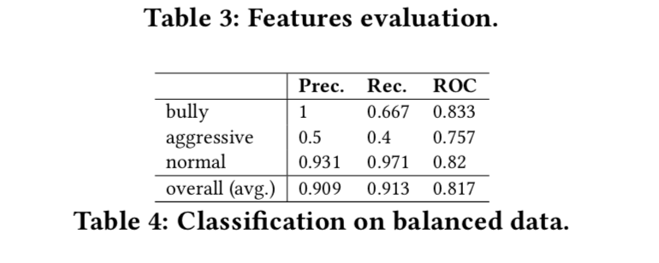
Model Training & Evaluation
Group D
Experimented with several types of decision trees
J48, LADTree, LMT, Nbtree, Functional Tree, Random Forsts
Under sampling and over sampling used in combination to resolve imbalance
Random Forest with 10 trees performed the best

Slide 24
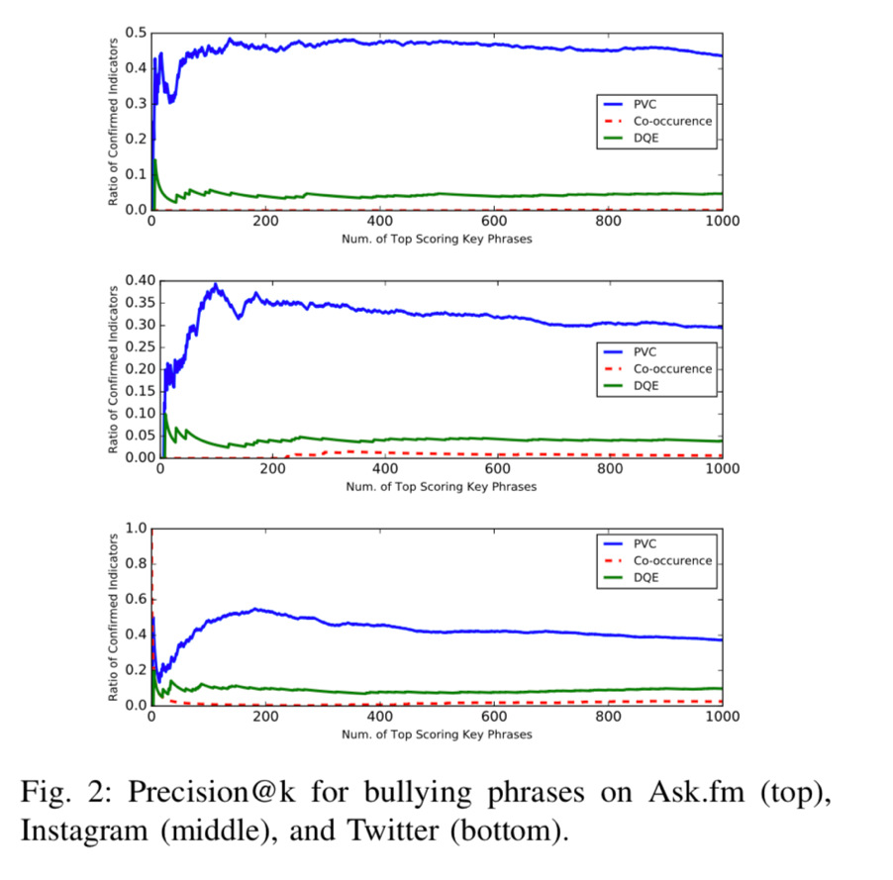
Model Training & Evaluation
Group E
Use their PVC model with Twitter, ASK.fm, and Instagram data
Detect cyberbullying via weakly supervised learning
PVC model identifies bully vs victim and additional words indicative of bullying

Slide 25
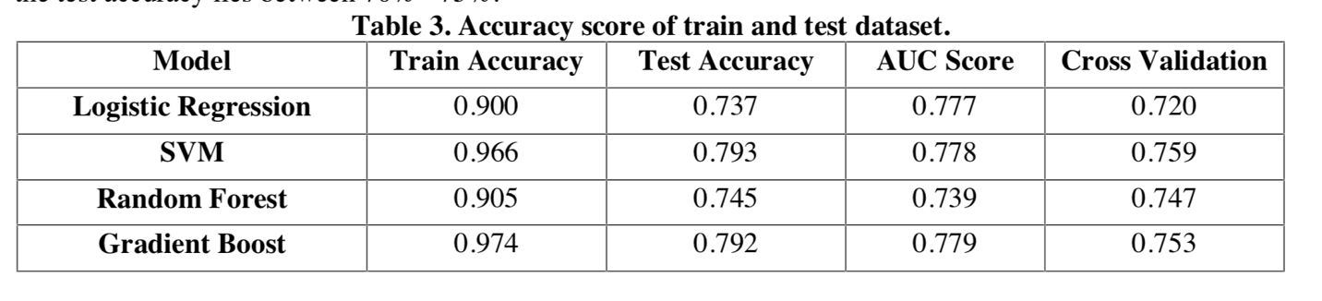
Model Training & Evaluation
Group F
Experimented with Logistic Regression, SVM, Random Forest, and Gradient Boosting
Gradient Boosting learner performed best with 79.2% accuracy

Slide 26
Model Training & Evaluation
Model and Evaluation Conclusions
SVM was popular classifier – known to have good results but is computationally expensive
Some groups preferred rule based learners and trees
Resulting knowledge representation more useful than black box SVM model
A lot of recent success in NLP with deep neural networks
Requires a lot of data
RNN and LSTM networks combined with word vectors can better capture text meaning
Use existing cyberbullying classifier to assist in long term data collection (1 year or continuous), increased data size will lend itself to complex neural network architectures

Slide 27
Conclusions
Cyberbullying is increasingly harder to monitor as social media activity grows
Machine learning systems can assist in cyberbullying detection
6 case studies from 2011 – 2018 compared
All groups manually scraped data from YouTube, Instagram, Twitter, Formspring.me, and ASK.fm
Groups manually labelled data or outsourced to Amazon’s Mechanical Turk
Most research groups used some form of a bag of words model
Groups that created additional POS, network based, and user profile features achieved better results
Increasing data size and quality will create opportunities to use complex deep neural networks that have proven success in NLP

Slide 28
References
Dinakar, K., Reichart, R., Liberman, H. (2011). “Modeling the Detection of Textual Cyberbullying”
Reynolds, K. (2011). “Using Machine Learning to Detect Cyberbullying”
Engman, L. (2016). “Automatic Detection of Cyberbullying on Socil Media”
Chatzakou, D., Kourtellis, N., Blackburn, J., De Cristofaro, E., Stringhini, G. (2017). “Mean Birds - Detecting Aggression and Bullying on Twitter”
Raisi, E., Huang, B. (2017). “Cyberbullying Detection with Weakly Supervised Machine Learning”
Sahay, K., Khaira, H., Kukreja, P., Shukla, N. (2018). “Detecting Cyberbullying and Aggression in Social Commentary Using NLP and Machine Learning”
Hosseinmardi, H., Mattson, S., Rafiq, R., Han, R., Lv, Q., Mishra, S. (2015). “Detection of Cyberbullying Incidents on the Instagram Social Network”
Pennington, J., Socher, R., Manning, C., (2014) “GloVe: Global Vectors for Word Representation”
Wolfe, L, (2017). “Twitter User Statistics 2008 Through 2017”
(2010). “Cyberbullying: A National Epidemic”, https://study.com

